Slide 1
Database design and Applications CSIZG518/SEZG518/SSZG518)(S1-21)
Uma Maheswari

Slide 2
Session 2
Topic : Database Design Process

Slide 3
LEARNING OUTCOME
Design of Database phases.
ER Modelling concepts
EER Concepts
REFER: T1-Chapter 3 and 4;
Sections:
3.1, 3.3-3.9, 4.1-4.3, 4.6

Slide 4
REVIEW of DBMS TERMS
Notes:
Schema – the overall design of DB that is not expected to change frequently
A database schema is the skeleton structure that represents the logical view of the entire database. It defines how the data is organized and how the relations among them are associated. It formulates all the constraints that are to be applied on the data.
Schema for the Big data applications is not done up front as with non big data applications
Metadata- data about data
Data dictionary – A special file that stores metadata.
Data model - Data models define how data is connected to each other and how they are processed and stored inside the system.

Slide 5
Phases of Database Design

Slide 6
Phases of Database Design
1. Requirements specification and analysis
2. Conceptual design
3. Logical design
4. Physical design

Slide 7
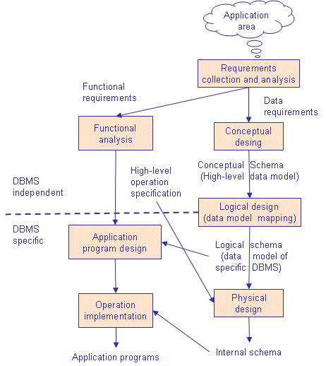
Phases of Database Design
Notes:
Note that some phases are database management system independent and some are dependent. The idea is to design first the database without thinking about the actual database system - just to concentrate on the data.

Slide 8
Phases of Database Design
1. Requirements specification and analysis
The requirements and the collection analysis phase produce both data requirements and functional requirements.
The data requirements are used as a source of database design.
The data requirements should be specified in as detailed and complete form as possible.

Slide 9
Phases of Database Design
2. Conceptual design
The result of this phase is an Entity-Relationship (ER) diagram or UML class diagram. It is a high-level data model of the specific application area.
It describes how different entities (objects, items) are related to each other. It also describes what attributes (features) each entity has. It includes the definitions of all the concepts (entities, attributes) of the application area.
During or after the conceptual schema design, the basic data model operations can be used to specify the high-level user operations identified during the functional analysis. This also serves to confirm that the conceptual schema meets all the identified functional requirements.
Notes:
In parallel with specifying the data requirements, it is useful to specify the known functional requirements of the application. These consist of user-defined operations that will be applied to the database (retrievals and updates). The functional requirements are used as a source of application software design. Of course some functions may produce also needs for database design.
1. Once all the requirements have been collected and analayzed, the next step is to create a conceptual schema for the database, using a high level conceptual data model. This phase is called conceptual design.

Slide 10
Phases of Database Design
3. Logical design
A. create relation schemas:
The result of the logical design phase (or data model mapping phase) is a set of relation schemas. The ER diagram or class diagram is the basis for these relation schemas.
To create the relation schemas is quite a mechanical operation. There are rules how the ER model or class diagram is transferred to relation schemas.
The relation schemas are the basis for table definitions. In this phase (if not done in previous phase) the primary keys and foreign keys are defined.

Slide 11
Phases of Database Design
3. Logical design
B. Normalization
Normalization is the last part of the logical design. The goal of normalization is to
eliminate redundancy and potential update anomalies.
Redundancy means that the same data is saved more than once in a database. Update anomaly is a consequence of redundancy. If a piece of data is saved in more than one place, the same data must be updated in more than one place.
Normalization is a technique by which one can modify the relation schema to reduce the redundancy. Each normalization phase adds more relations (tables) into the database.

Slide 12
Phases of Database Design
4. Physical design
The goal of the last phase of database design, physical design, is to implement the database. At this phase one must know which database management system (DBMS) is used.
For example, different DBMS's have different names for datatypes and have different datatypes.
The SQL clauses to create the database are written. The indexes, the integrity constraints (rules) and the users' access rights are defined.
Finally the data to test the database is added in.

Slide 13
Eg, UNIVERSITY database
STEP A: ANALYZE THE PROBLEM
Step1 :
What does this DB do?
Information concerning students, courses, and grades in a university environment
Step2 :
What are the Data records?
STUDENT
COURSE
SECTION
GRADE_REPORT
PREREQUISITE
Step 3:
Step Specify structure of records of each file by specifying data type for each data
element
String of alphabetic characters
Integer
Etc.

Slide 14
UNIVERSITY database contd…
Step B: Relate the records.
Step 4: Construct UNIVERSITY database
Store data to represent each student, course, section, grade report, and prerequisite as a record in appropriate file
Step 5: Relationships among the records
Step 6: Manipulation involves querying and updating

Slide 15
Examples of Queries and Updates:
Examples of queries:
Retrieve the transcript
List the names of students who took the section of the ‘Database’ course offered in fall 2008 and their grades in that section
List the prerequisites of the ‘Database’ course
Examples of updates:
Change the class of ‘Smith’ to sophomore
Create a new section for the ‘Database’ course for this semester
Enter a grade of ‘A’ for ‘Smith’ in the ‘Database’ section of last semester

Slide 16

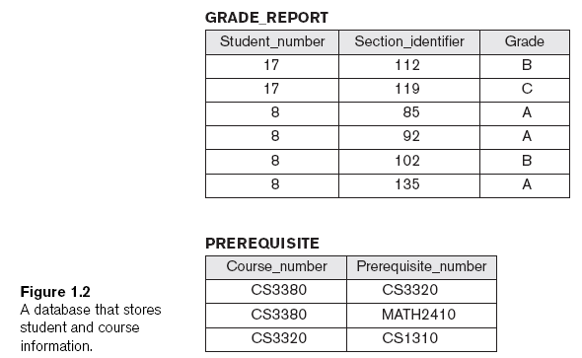
UNIVERSITY Database designed as:

Slide 17
Conceptual design of DB

Slide 18
Conceptual Database Design:
The information gathered in the requirements analysis step is used to
develop a high-level description of the data to be stored in the database,
along with the constraints that are known to hold over this data.
This step is often carried out using the ER model.

Slide 19
Domains, Attributes, Tuples, and Relations
Notes:
1. For each attribute associated with an entity set, we must identify a domain of possible
values. For example, the domain associated with the attribute name of Employees
might be the set of 20-character strings.

Slide 20
SEMANTIC DATA MODEL

Slide 21
ENTITY RELATIONSHIP

Slide 22
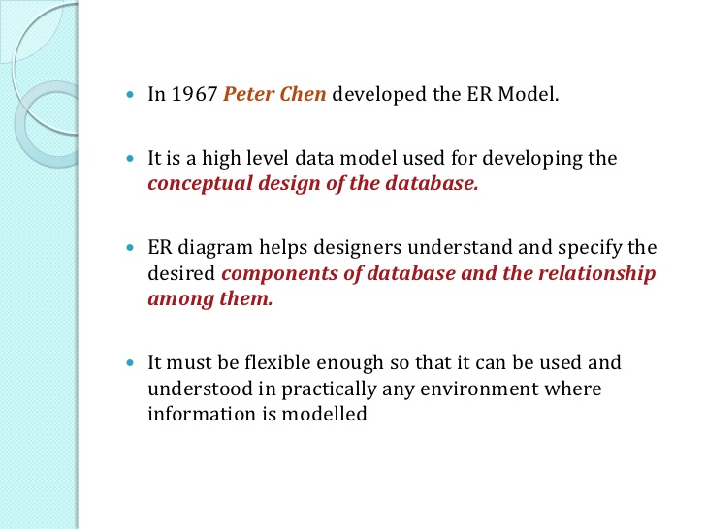
ENTITY RELATIONSHIP DIAGRAM

Slide 23
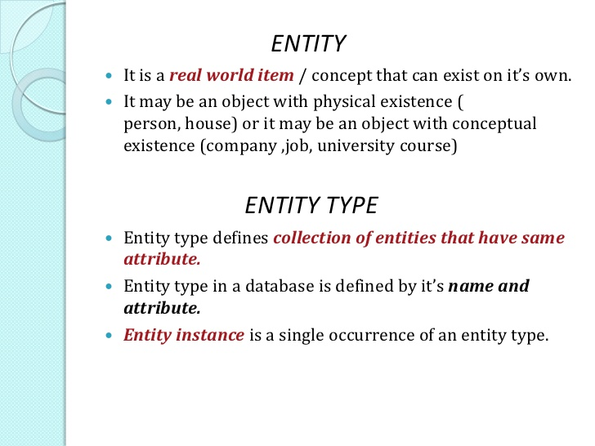
ENTITY in ER diagram

Slide 24
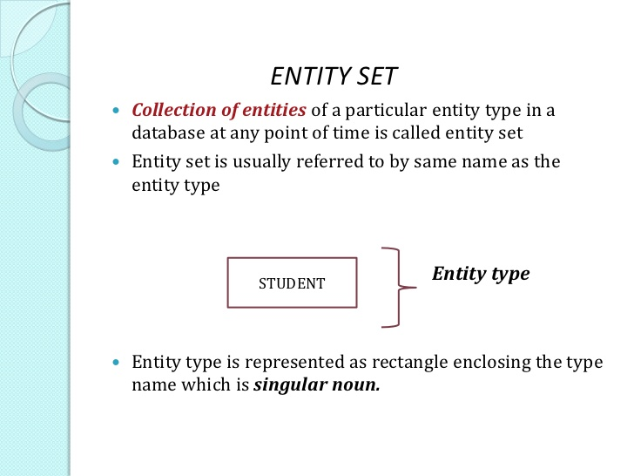
ENTITY SET in ER diagram

Slide 25
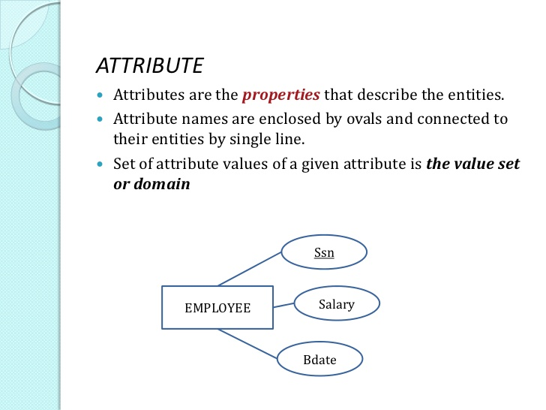
ATTRIBUTE in ER diagram

Slide 26
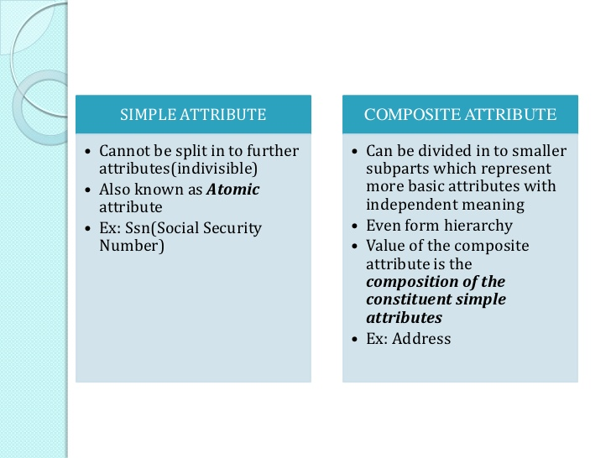
TYPES OF ATTRIBUTES

Slide 27
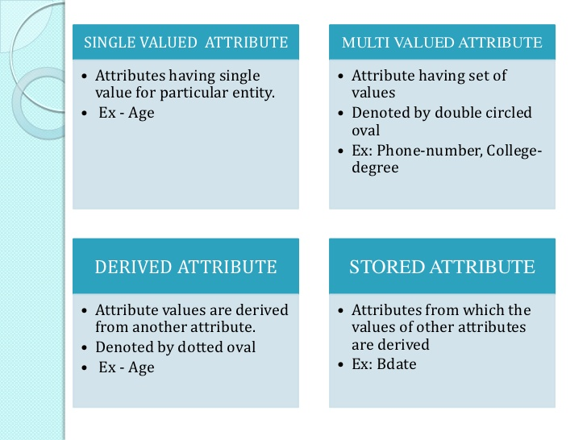
TYPES OF ATTRIBUTES (contd.)

Slide 28
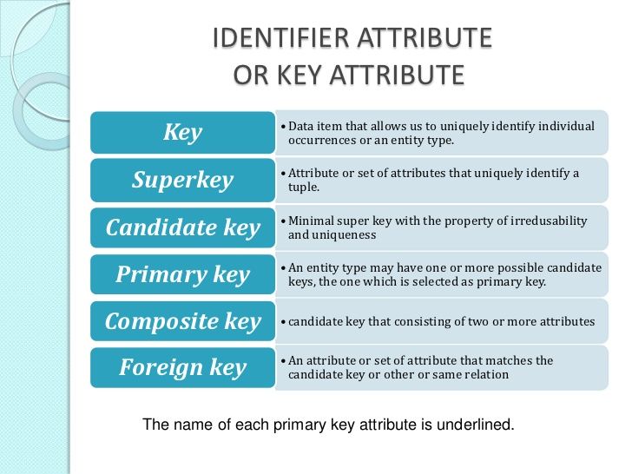
ENTITY in ER diagram

Slide 29
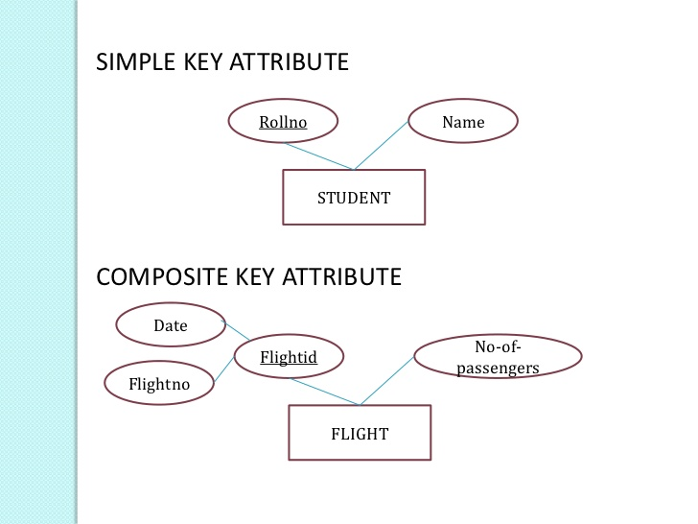
Simple ER diagrams

Slide 30
KEYS
Entities and relationships are distinguishable using various keys
A key is a combination of one or more attributes, e.g., social-security number, combination of name and social-security number.
A superkey is a key defined either for an entity set or relationship set that uniquely identifies an entity, e.g., social-security number, phone number, combination of name and social-security number.
A candidate key is a minimal superkey that uniquely identifies either an entity or a relationship, e.g., social-security number, phone number.
A primary key is a candidate key that is chosen by the database designer to identify the entities of an entity set.

Slide 31
KEYS
A foreign key is a set of one or more attributes of a strong entity set that are employed to construct the discriminator of a weak entity set. The primary key of a weak entity set is formed by the primary key of the strong entity set on which it is existence-dependent.
Relationship sets also have primary keys. Assume R is a relationship set involving entity sets E₁, E₂, ..., E_{n}. Let primary-key(E_{i}) denote the primary key for entity set E_{i}. Assume primary-key(E_{i}) is unique for 1 ≤ i ≤ n. If R has no attributes then its superkey is:
primary-key(E₁) ∪ primary-key(E₂) ∪ ... ∪ primary-key(E_{n})
This is a primary key if the mapping constraint is many-to-many.
If the mapping constraint is many to one from E₁ to E₂ then the primary key of R is primary key of E₁.

Slide 32
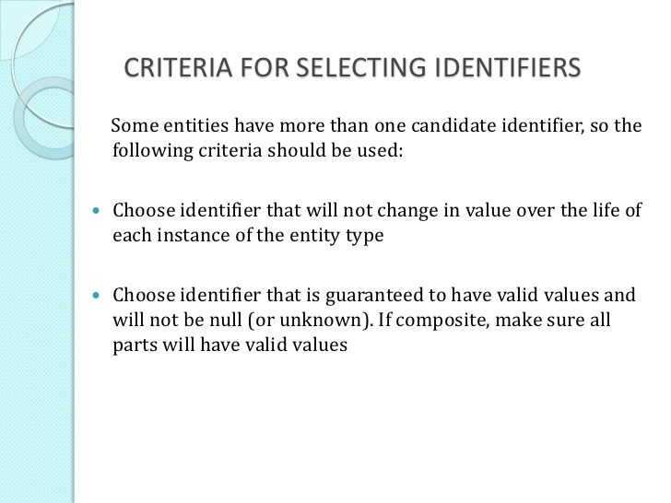
ER Models

Slide 33
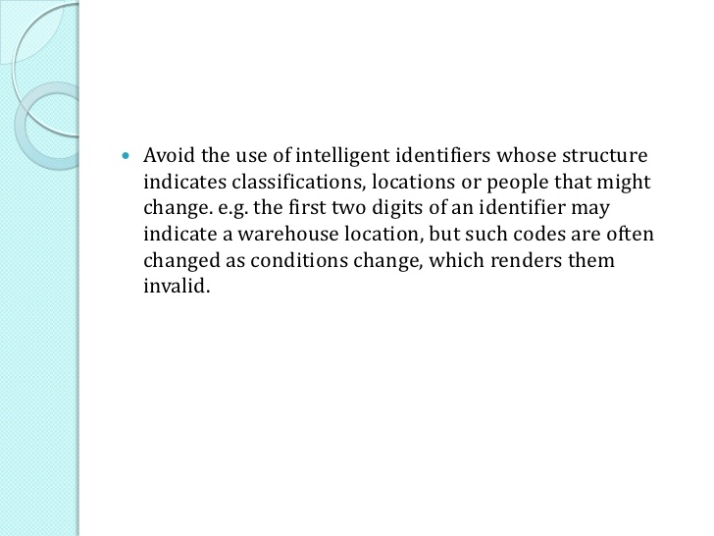
ER Models

Slide 34
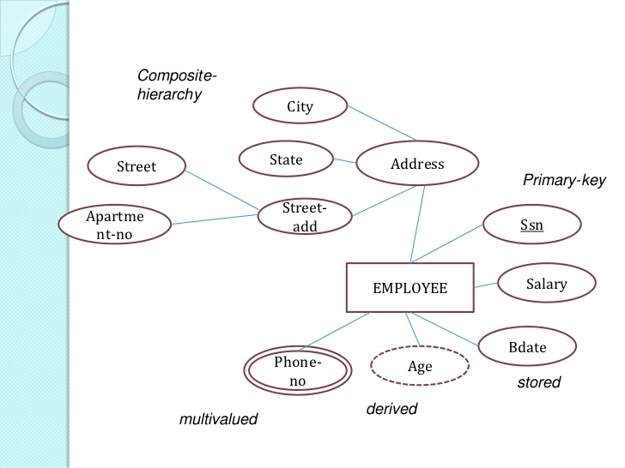
ER Models

Slide 35
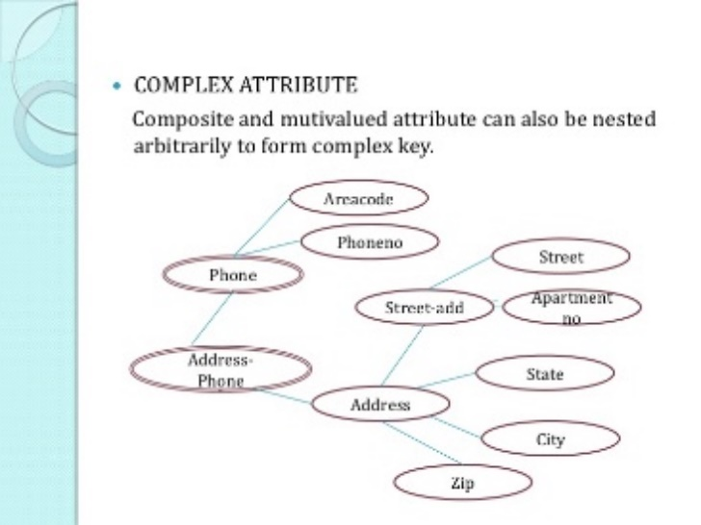
ER Models

Slide 36
QUESTION???

Slide 37
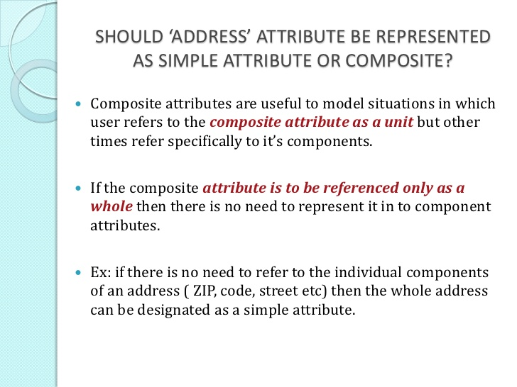
ER Models

Slide 38
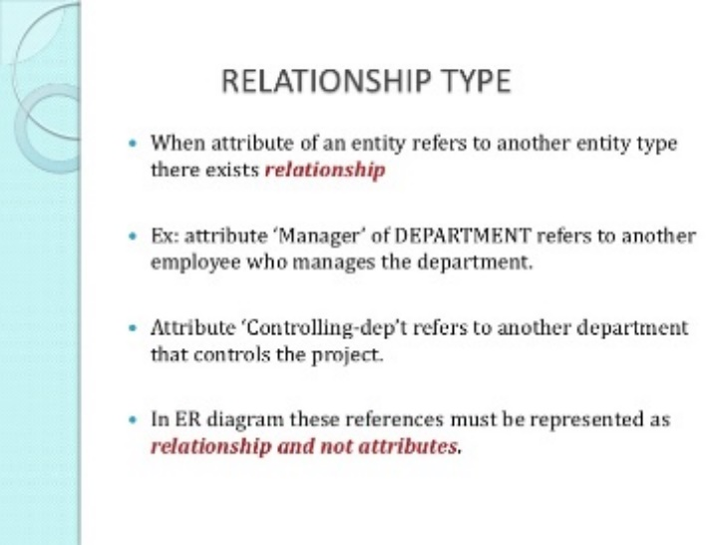
ER Models

Slide 39
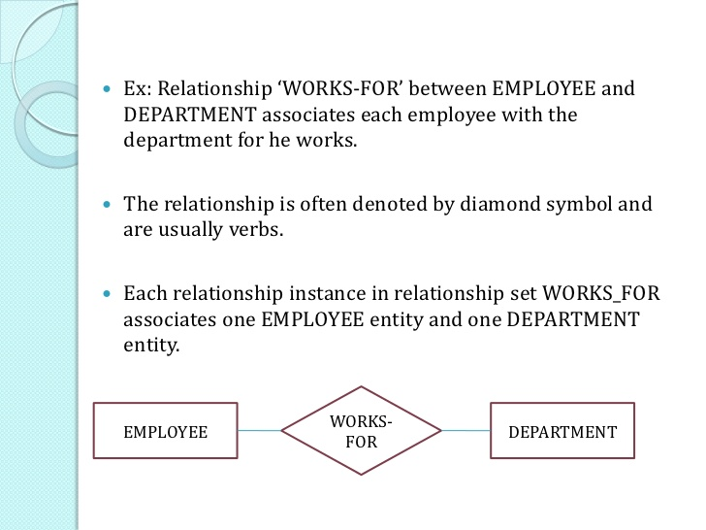
ER Models

Slide 40
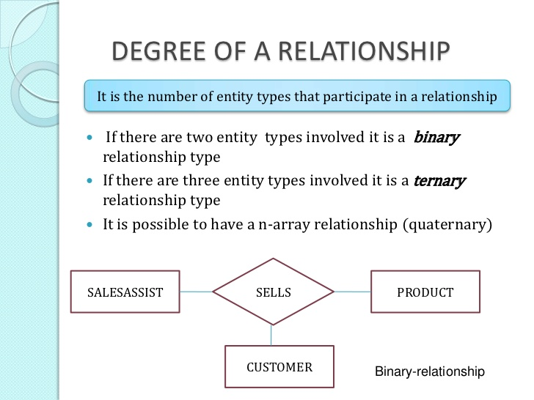
ER Models

Slide 41
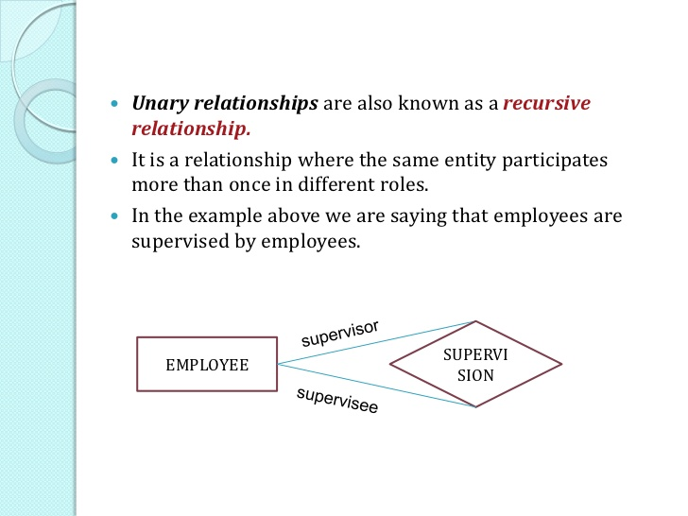
ER Models

Slide 42
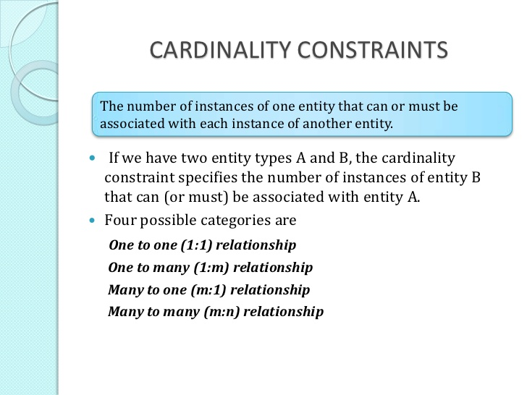
ER Models

Slide 43
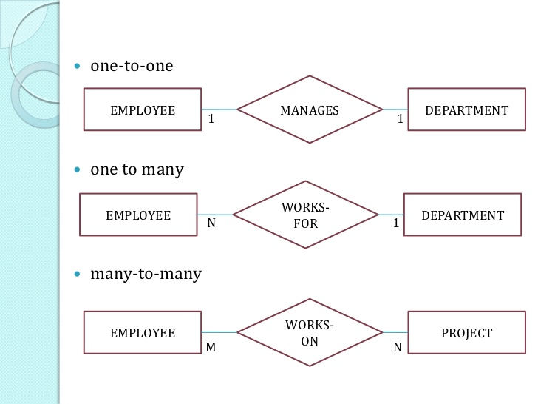
ER Models

Slide 44
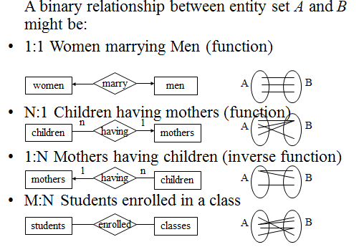

Slide 45
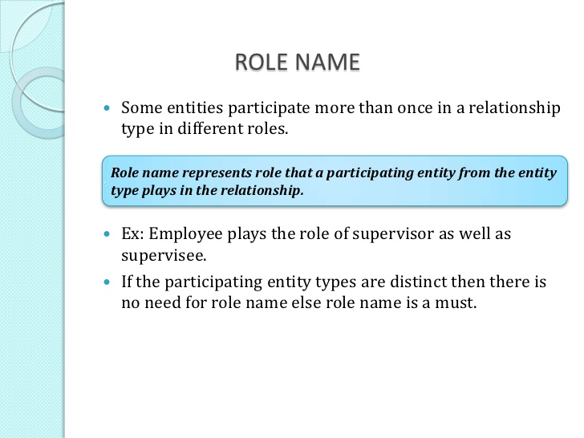
ER Models

Slide 46
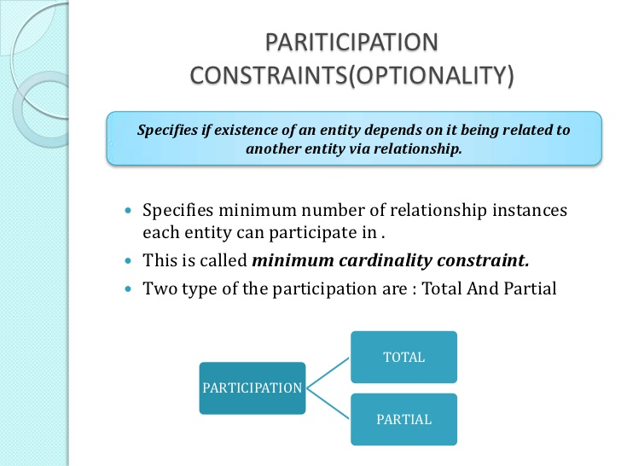
ER Models

Slide 47
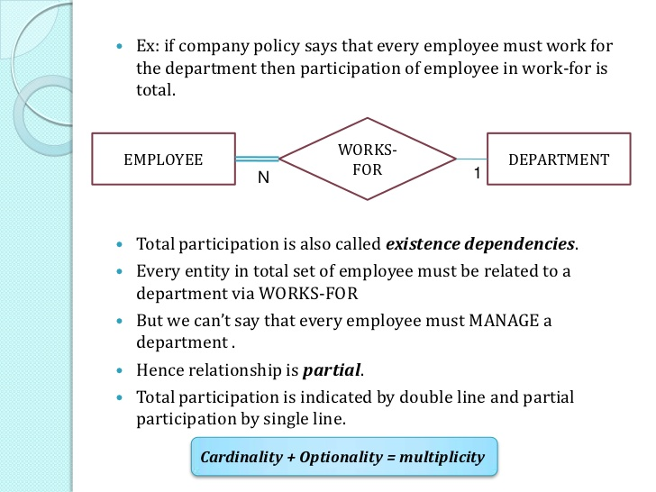
ER Models

Slide 48
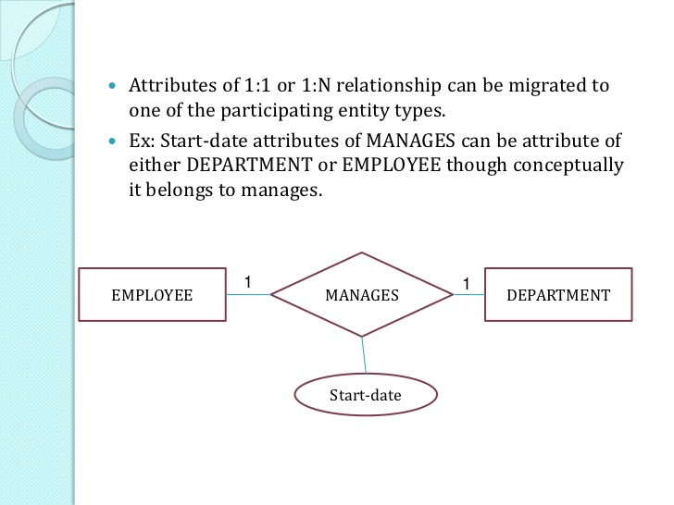
ER Models

Slide 49
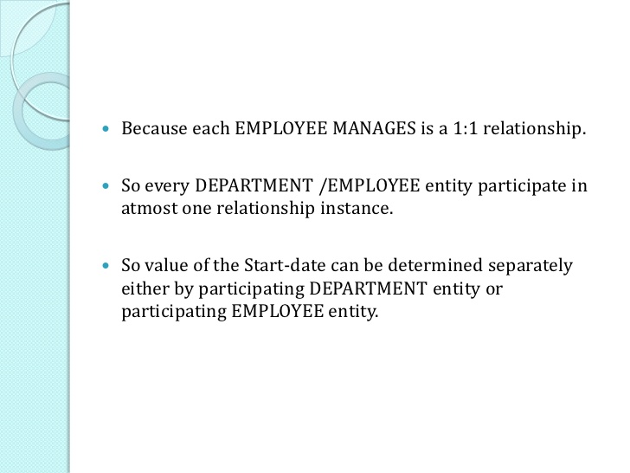
ER Models

Slide 50
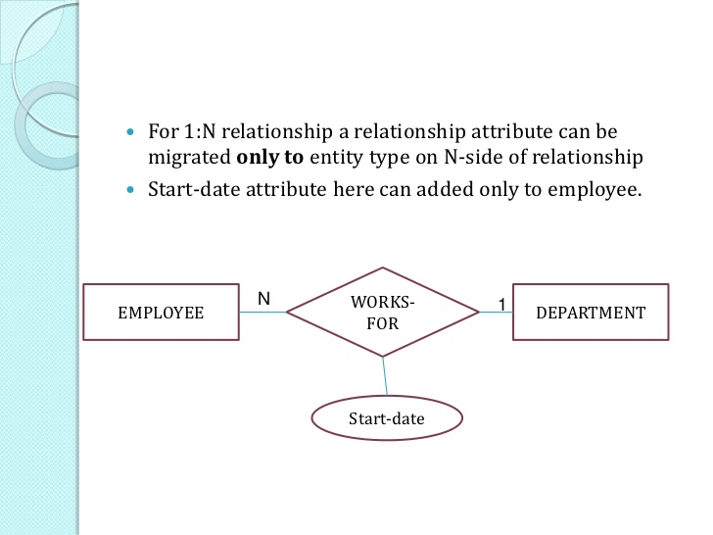
ER Models

Slide 51
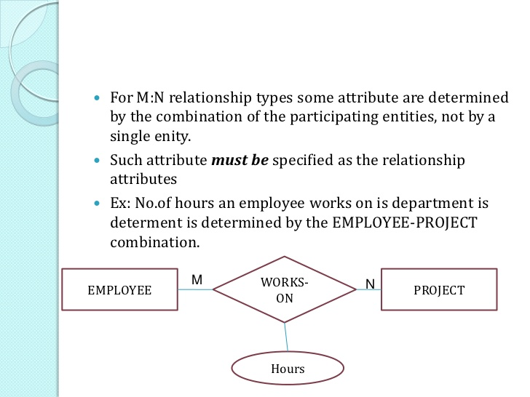
ER Models

Slide 52
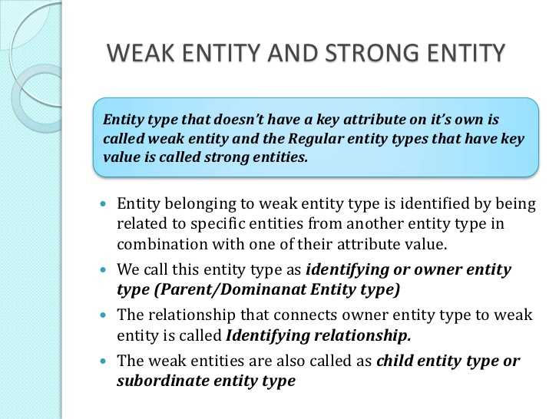
ER Models

Slide 53
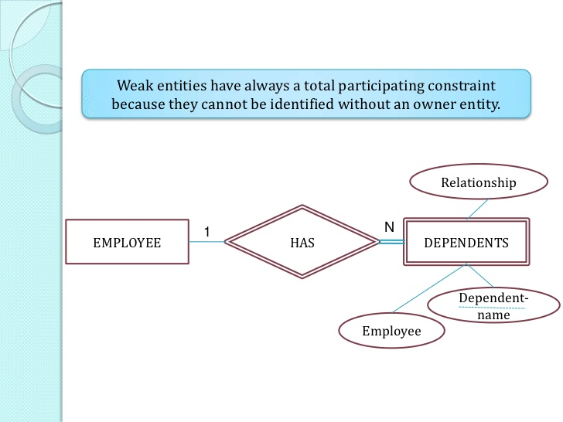
ER Models

Slide 54
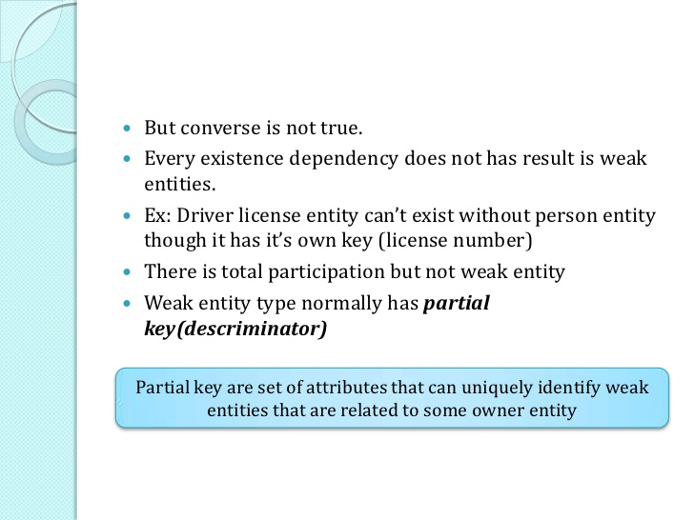
ER Models

Slide 55
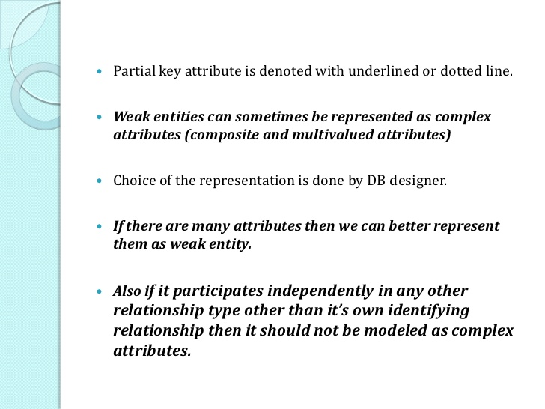
ER Models

Slide 56
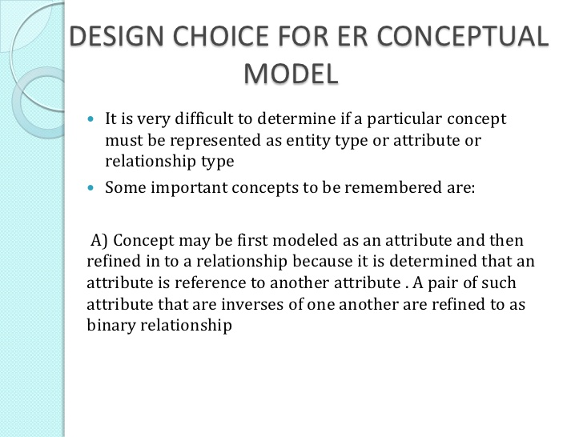
ER Models

Slide 57
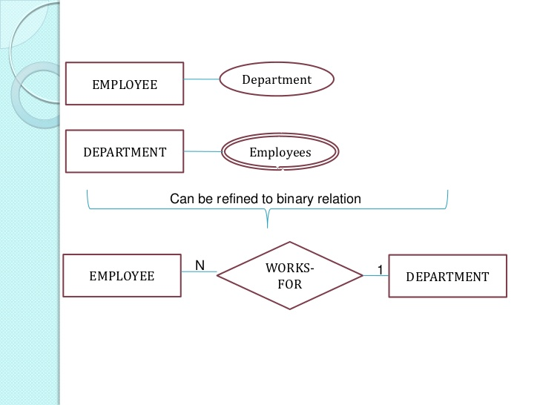
ER Model

Slide 58
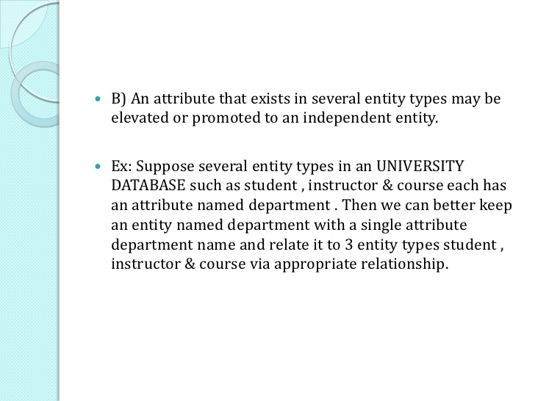
ER Model

Slide 59
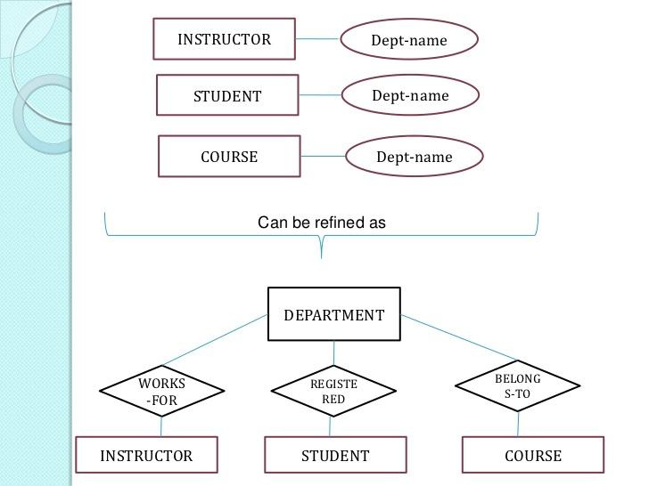
ER Model

Slide 60
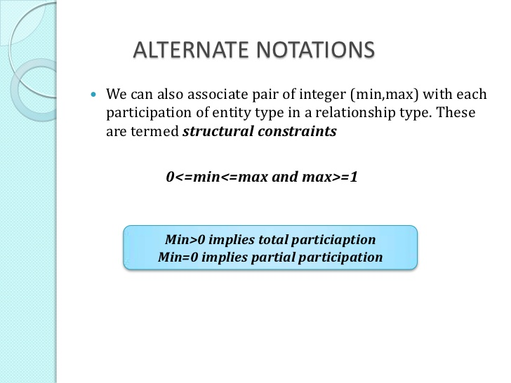
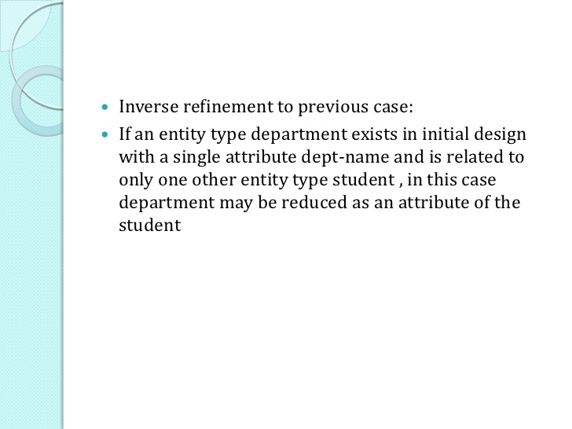
ER Model

Slide 61
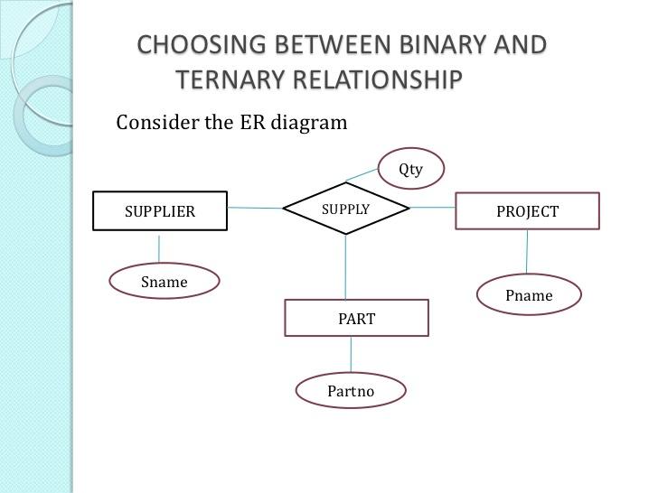
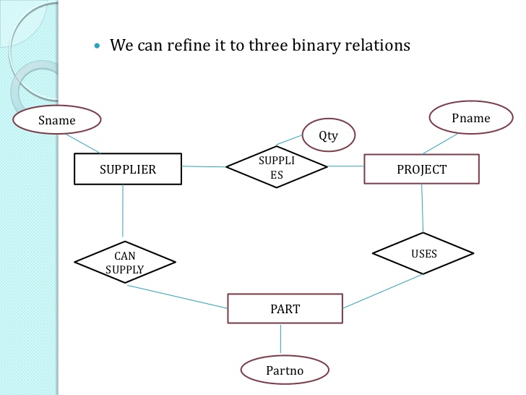
ER Model

Slide 62
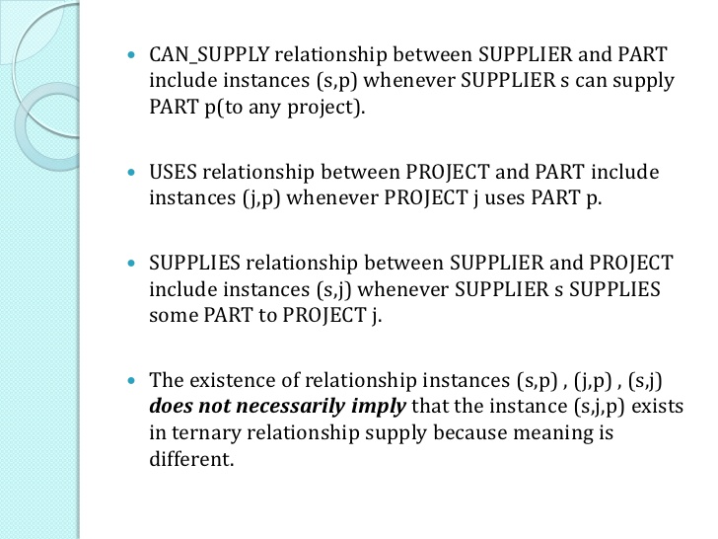
ER Model

Slide 63
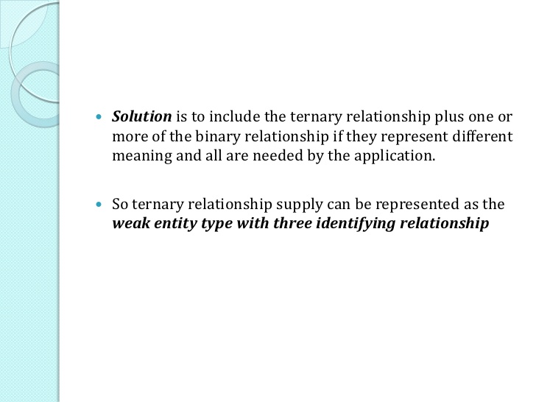
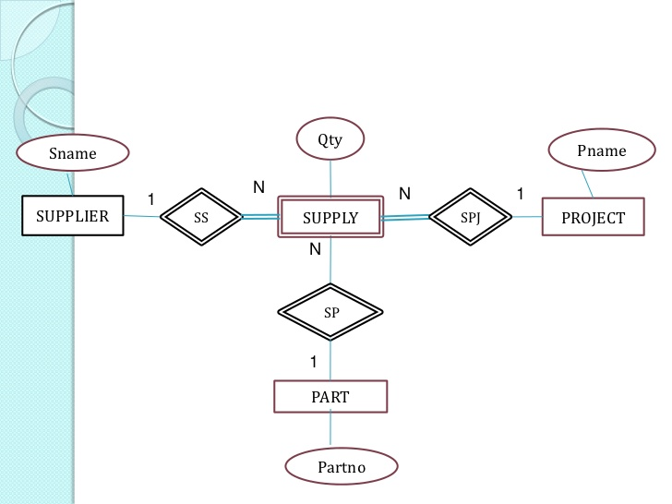
ER Model

Slide 64
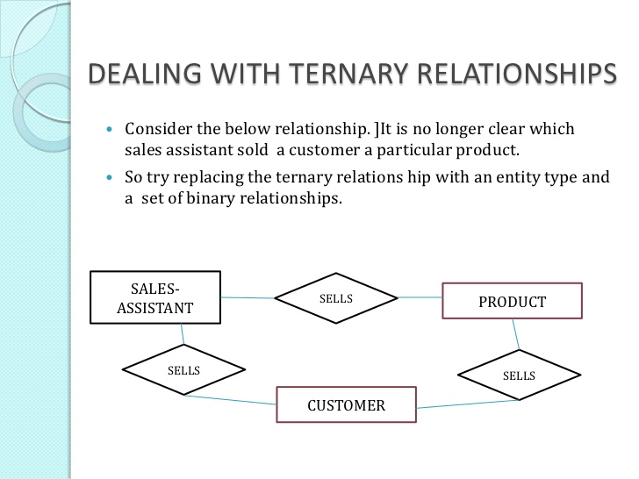
ER Model

Slide 65
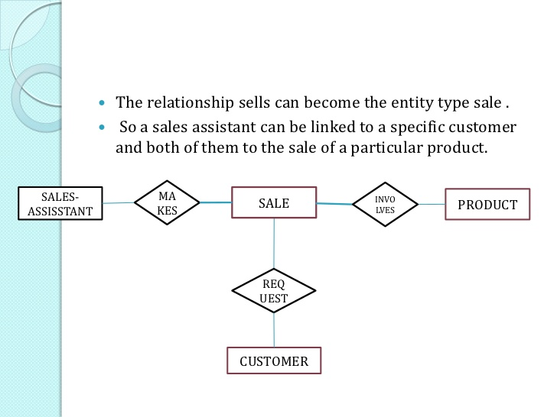
ER Model

Slide 66
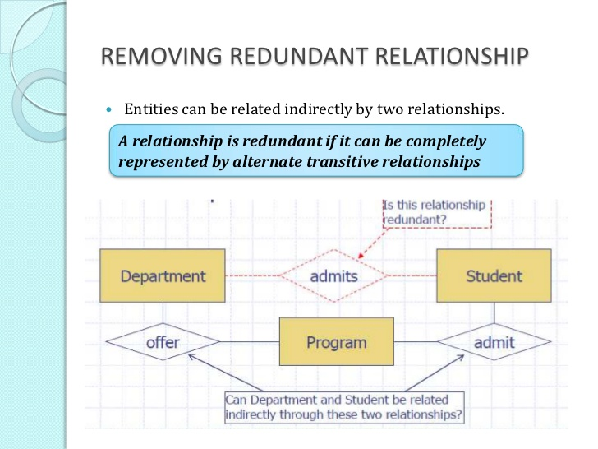
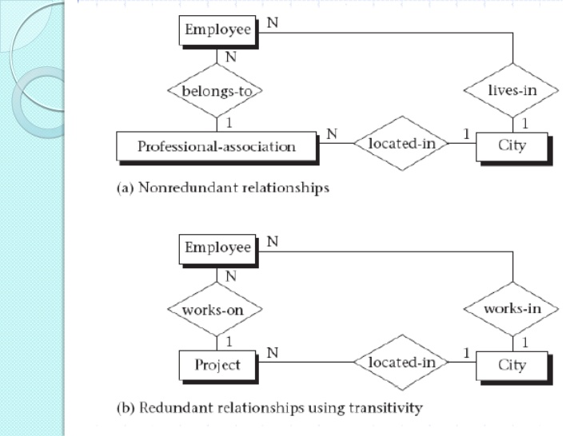
ER Model

Slide 67
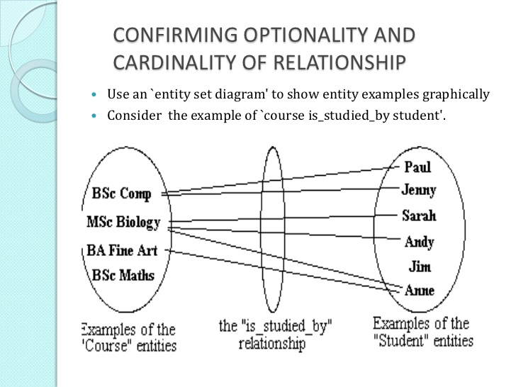
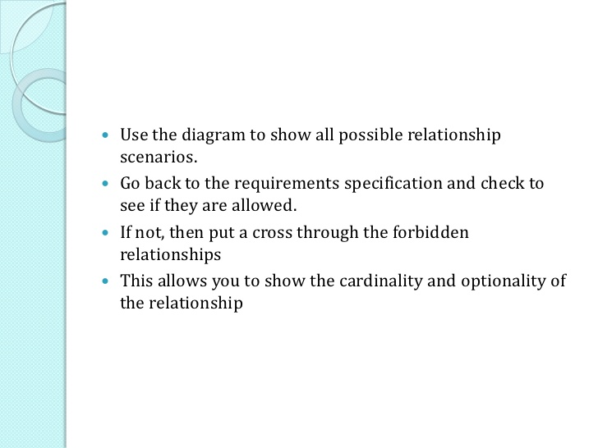
ER Model

Slide 68


ER Model

Slide 69

ER Model

Slide 70


Slide 71


Other Notations of ER Models

Slide 72


Other Notations of ER Models

Slide 73


Other Notations of ER Models

Slide 74



Slide 75


CONSTRUCTING ER Model
Notes:
1. Identify all the relevant entities in a given system and determine the relationships among these entities.
2. An entity should appear only once in a particular diagram.
3. Provide a precise and appropriate name for each entity, attribute, and relationship in the diagram. Terms that are simple and familiar always beats vague, technical-sounding words. In naming entities, remember to use singular nouns. However, adjectives may be used to distinguish entities belonging to the same class (part-time employee and full time employee, for example). Meanwhile attribute names must be meaningful, unique, system-independent, and easily understandable.
4. Remove vague, redundant or unnecessary relationships between entities.
5. Never connect a relationship to another relationship.
6. Make effective use of colors. You can use colors to classify similar entities or to highlight key areas in your diagrams.

Slide 76


CONSTRUCTING ER Model
Notes:
1. Identify all the relevant entities in a given system and determine the relationships among these entities.
2. An entity should appear only once in a particular diagram.
3. Provide a precise and appropriate name for each entity, attribute, and relationship in the diagram. Terms that are simple and familiar always beats vague, technical-sounding words. In naming entities, remember to use singular nouns. However, adjectives may be used to distinguish entities belonging to the same class (part-time employee and full time employee, for example). Meanwhile attribute names must be meaningful, unique, system-independent, and easily understandable.
4. Remove vague, redundant or unnecessary relationships between entities.
5. Never connect a relationship to another relationship.
6. Make effective use of colors. You can use colors to classify similar entities or to highlight key areas in your diagrams.

Slide 77

CONSTRUCTING ER Model
Notes:
1. Identify all the relevant entities in a given system and determine the relationships among these entities.
2. An entity should appear only once in a particular diagram.
3. Provide a precise and appropriate name for each entity, attribute, and relationship in the diagram. Terms that are simple and familiar always beats vague, technical-sounding words. In naming entities, remember to use singular nouns. However, adjectives may be used to distinguish entities belonging to the same class (part-time employee and full time employee, for example). Meanwhile attribute names must be meaningful, unique, system-independent, and easily understandable.
4. Remove vague, redundant or unnecessary relationships between entities.
5. Never connect a relationship to another relationship.
6. Make effective use of colors. You can use colors to classify similar entities or to highlight key areas in your diagrams.

Slide 78
Example 1 design ER
Consider a mail order database in which employees take orders for parts from customers. The data requirements are summarized as follows:
The mail order company has employees identified by a unique employee number, their first and last names, and a zip code where they are located.
Customers of the company are uniquely identified by a customer number.
In addition, their first and last names and a zip code where they are located are recorded.
The parts being sold by the company are identified by a unique part number. In addition, a part name, their price, and quantity in stock are recorded.
Orders placed by customers are taken by employees and are given a unique order number. Each order may contain certain quantities of one or more parts and their received date as well as a shipped date is recorded.
Design an Entity-Relationship diagram for the mail order database.

Slide 79
Solution
Step 1: Identify the Entities: Employee, Customer, Parts, Order
Step 2: Identify the attributes of each entity:
Employee => enum, fname, lname, zipcode
Customer => custnum, fname,lname,zipcode
Parts => partnum, price, qtyinhand
Order =>ordernum,recvddate, partnum,qty,shippeddate
Step 3:
Consider the “The mail order company has employees identified by a unique employee number, their first and last names, and a zip code where they are located”

Slide 80
Solution
Step 4 :
2.Consider the “ Customers of the company are uniquely identified by a customer number. In addition, their first and last names and a zip code where they are located are recorded.”
Step 5 :
3.Consider the “The parts being sold by the company are identified by a unique part number. In addition, a part name, their price, and quantity in stock are recorded.”

Slide 81
Solution
Step 6 :
4. consider the “Orders placed by customers are taken by employees and are given a unique order number. Each order may contain certain quantities of one or more parts and their received date as well as a shipped date is recorded.”

Slide 82

Example 2 design ER Model

Slide 83


Example of CONSTRUCTION ER Model

Slide 84


Example of CONSTRUCTION ER Model

Slide 85

Example of CONSTRUCTION ER Model

Slide 86


Enhanced ER or EER Models

Slide 87


EER Model

Slide 88


Other Notations of ER Models

Slide 89


EER Models

Slide 90


EER Models

Slide 91


EER Models

Slide 92


EER Models

Slide 93

EER Models

Slide 94

EER Models

Slide 95

EER Models

Slide 96

EER Models

Slide 97
UNION of CATOGORIES:
In specialisation and generalisation the deletion of an entity from a super class implies automatic deletion from subclasses belonging to the same;
similarly insertion of an entity in a super class implies that the entity is
mandatorily inserted in all attribute defined subclass for which the entity
satisfies the defining predicate.
But in case of total specialisation, insertion of an entity in a super class implies compulsory insertion in at least one of the subclasses of the specialisation.

Slide 98
UNION of CATOGORIES:
In some cases, a single class has a similar relationship with more than one class.
For example, the sub class ‘car’ may be owned by two different types of owners:
INDIVIDUAL or ORGANISATION. Both these types of owners are different classes thus such a situation can be modelled with the help of a Union.
UNION comes into play when you want to represent two or more superclass for a subclass.

Slide 99

UNION of CATOGORIES:

Slide 100
Converting EER diagram to table
The rules for converting EER diagram – which primarily includes specialisation and generalisation hierarchy are the same as in ER diagram. Let us recapitulate the rules:
• Create a table for each strong entity set.
• Create a table for a weak entity set; however, include the primary key of the
strong entity on which it depends in the table.
• Create a table for each binary m : n relationship set having the primary keys of both the participating entities;
For a binary m : 1 or 1 : m relationship, the primary key on the m side should be used as the primary key.
For binary 1:1 relationship set the primary key is chosen from any of the participating relations.

Slide 101
Converting EER diagram to table
• Composite attribute may sometimes be converted to a separate table.
• For generalisation or specialisation hierarchy a table can be created for higher
level and each of the lower level entities. The higher level entity would have the
common attributes and each lower level table would have the primary key of
higher level entity and the attributes defined at the lower specialised level.
However, for a complete disjoint hierarchy no table is made at the higher level,
but the tables are made at the lower level including the attributes of higher level.
• For an aggregation, all the entities and relationships of the aggregation are
transformed into the table on the basis of the above rules. The relationship that
exists between the simple entity and the aggregated entity, have the primary key
of the simple entity and the primary key of the relationship of the aggregated
entity.

Slide 102
Example EER design.
The EER diagram below describes the database of a training center, including information about its members, training activities and bookings.
Each member is identified through his/her e-mail address. Gold-members can book any training activity, while common members can only book core activities.
For each training activity, the database stores the schedule (week, week day, and time), the room, the leader and the e-mail of the leader. Each leader leads several activities per week, but the same activities every week.
Translate the EER diagram into a relational model. Mark each primary key with a straight underline, and each foreign key with a dotted underline. For the foreign keys, mark the attributes that are referred by the foreign keys by means of arrows

Slide 104

EER Models Design: Example

Slide 105

EER Models Design: Example

Slide 106

EER Models Design: Example

Slide 107

EER Models Design: Example

Slide 108

EER Models Design: Example

Slide 109

EER Models Design: Example

Slide 110
SUMMARY
Database design Phases.
Conceptual Design.
ER diagram.
EER diagram.

